Slide 1
Mobile Device Usage
Group 1: Kim Crespo, Brian Loutzenhiser, Bryson Desinor, and Alex Maciel

Slide 2
Group 1 Project Agenda
Our goal is to predict key metrics of user behavior, such as Battery Drain and App Usage Time. These insights can help developers optimize app performance and reduce battery consumption.
Problem Statement
Correlation between the five factors
Predicting the Importance Features
How does Age Impact Phone Usage
Device and Gender on the Five Factors

Slide 3

Problem Statement
What are some factors in phone usage behavior?
How can these insights help developers optimize app performance and reduce battery consumption?
Why this matters? Efficient mobile devices can reduce environmental impact.
https://www.weforum.org/agenda/2014/09/mobile-phones-energy-efficient/#:~:text=The%20result%20is%20that%20mobile,nearly%205%20million%20American%20homes.

Slide 4
The Five Factors
App Usage Time (min/day)- Daily time spent on mobile applications, measured in minutes.
Screen On Time (hours/day)- Average hours per day the screen is active.
Battery Drain (mAh/day)- Daily battery consumption in mAh.
Number of Apps Installed- Total apps available on the device.
Data Usage (MB/day)- Daily mobile data consumption in megabytes.

Slide 5
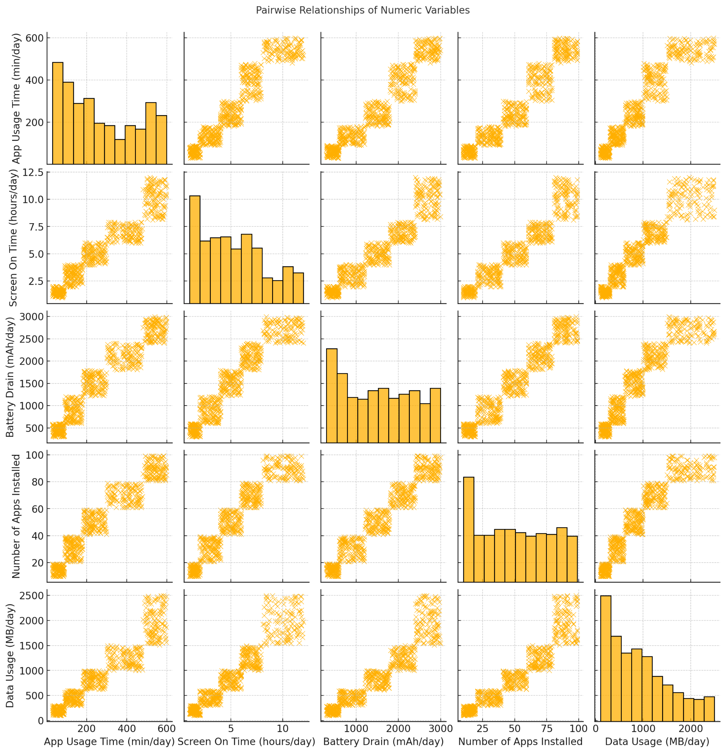
Pairwise Relationships
Each diagonal plot shows a histogram representing the distribution of one variable.
The strong, almost linear relationship between App Usage, Screen on Time, Battery Drain suggest that these factors are closely tied together. Reducing app usage, or optimizing screen-on time could have a direct impact on reducing battery drain.
Users with more installed apps and higher data usage also tend to have higher App Usage Time and Battery Drain, though these relationships are not as strong as those involving Screen On Time and Battery Drain.
In each scatter plot, we notice several outliers—users who fall outside the common ranges of app usage or battery consumption. These heavy users likely represent power users who engage deeply with apps, leading to higher data usage and battery consumption.
The strongest relationships, particularly between App Usage Time and Battery Drain, suggest that app developers and businesses can significantly reduce battery drain by optimizing app performance during screen-on periods.

Slide 6
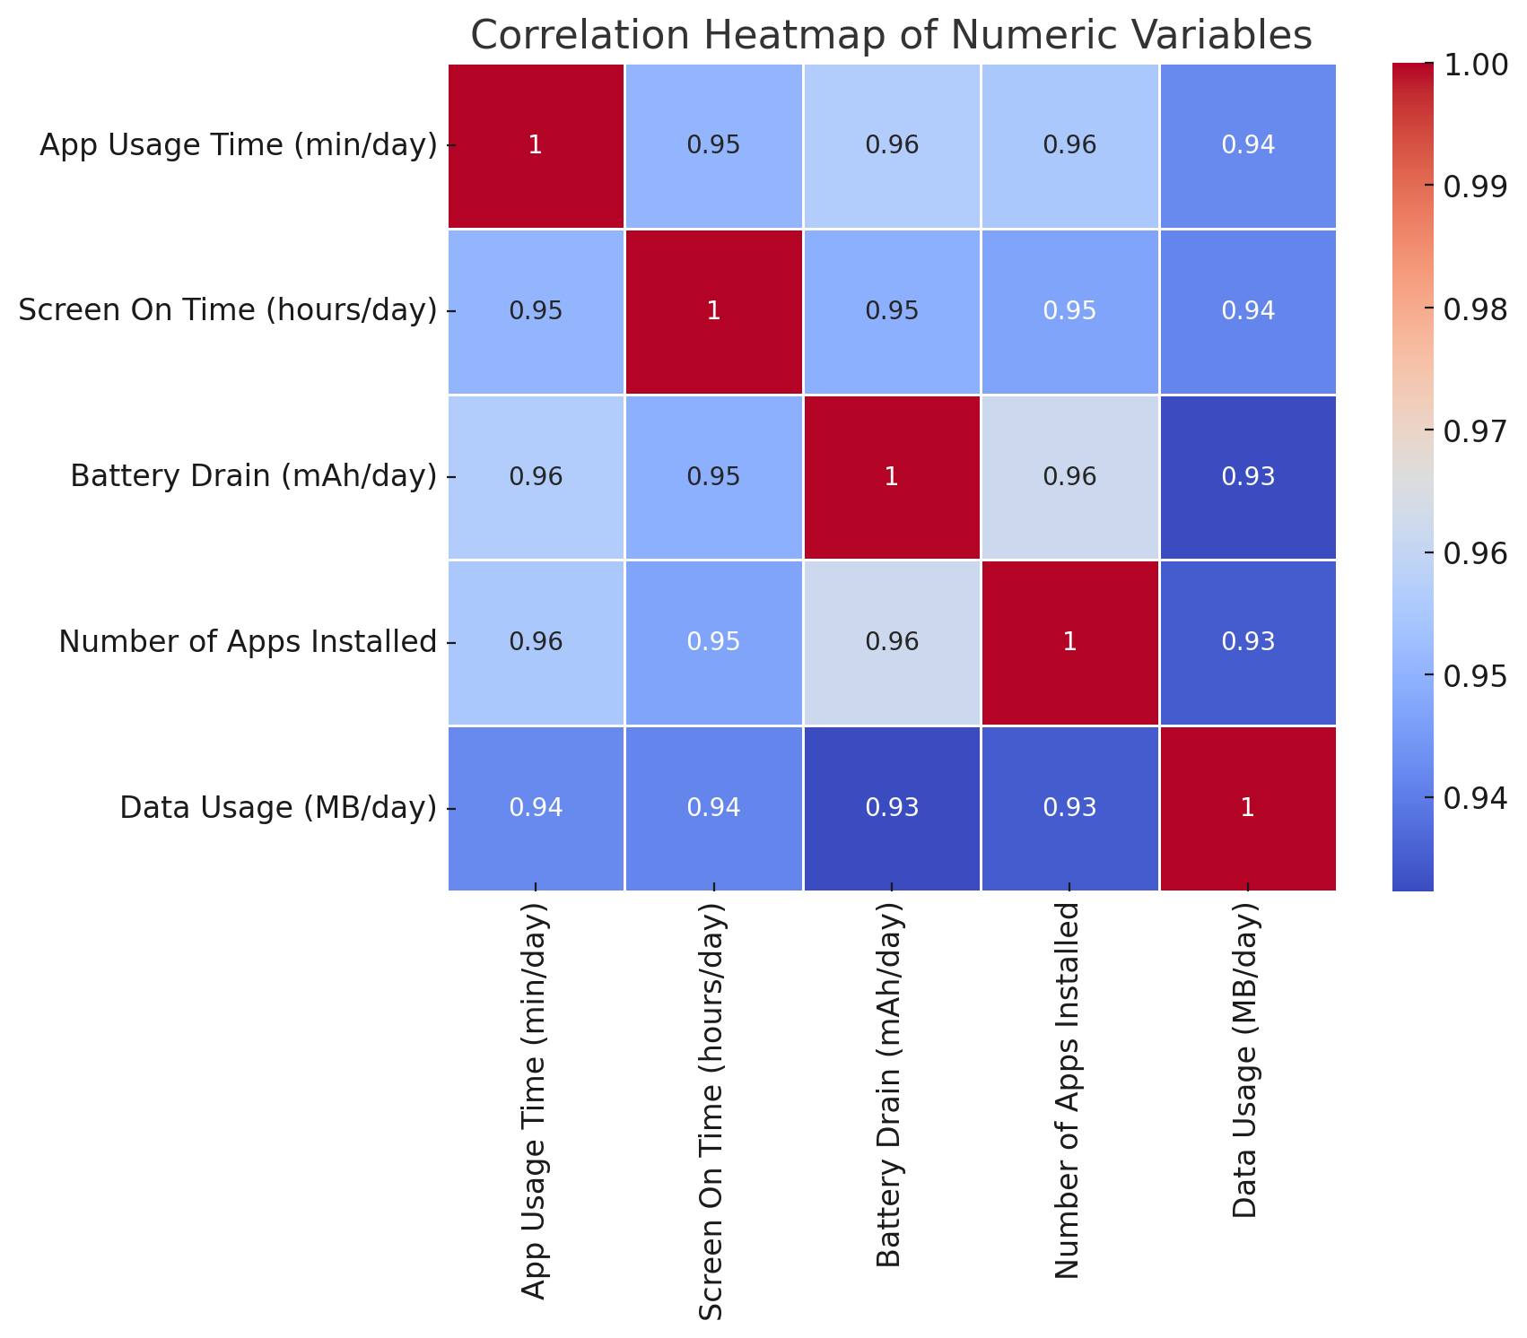
Correlation between the five factors
This heat map illustrates the correlation between the five key variables.
Correlation values range from -1 to 1:
+1 means a perfect positive correlation, indicating that as one variable increases, the other also increases proportionally.
0 means no correlation between the variables.
-1 means a perfect negative correlation, indicating that as one variable increases, the other decreases.
The heatmap reveals extremely strong correlations (0.93–0.96) between most of the variables, suggesting that App Usage Time, Battery Drain, Screen On Time, Number of Apps Installed, and Data Usage are all tightly connected in user behavior.
The strongest correlation in the heatmap (0.96) between App Usage Time and Battery Drain suggests that app usage is one of the most influential factors on battery consumption. Users who spend more time on apps not only use more data but also experience significantly higher battery drain.
The high correlation between Data Usage and Battery Drain (0.93) underscores the impact of data-heavy apps on battery life. Apps that require a lot of data, such as streaming services, social media, and video calls, can drain the battery quickly.
This suggest that future developers may want to focus on optimizing battery usage, particularly by managing app activity and screen-on time. Overall reducing the data footprint of their apps.

Slide 7
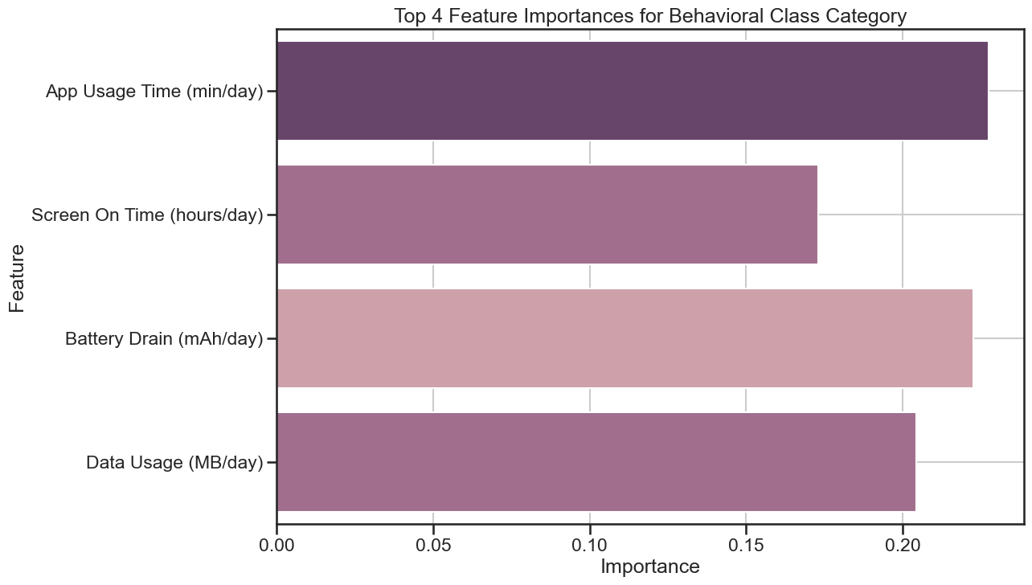
Predicting the Importance Features
Top Features correlating on Behavior classes being App Usage Time and Battery Drain.
We can see that “App Usage” being the main correlation to higher behavior category.
Further proving that it’s important for developers to optimize device battery.

Slide 8
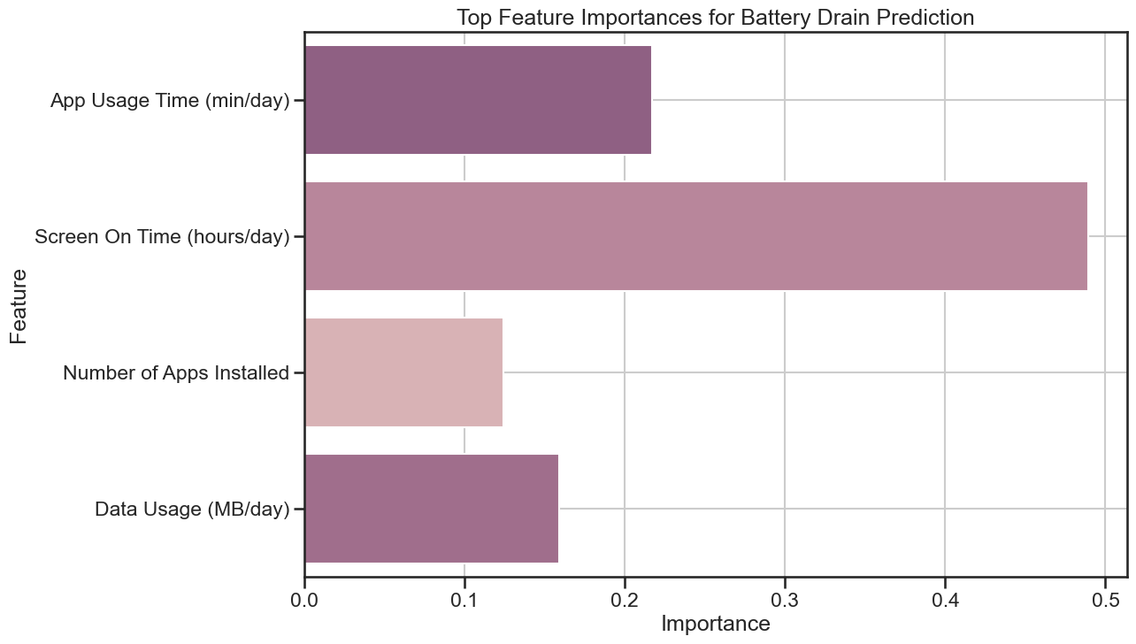
Important Feature Correlation to Battery Drain
Top feature importance to battery drain is Screen On Time.
Intriguing to see that the data shows that app usage time and screen on time do not match.
It is important to have the device screen on standby/timeout settings on by default to the lowest timer setting to further optimize phone usage.

Slide 9
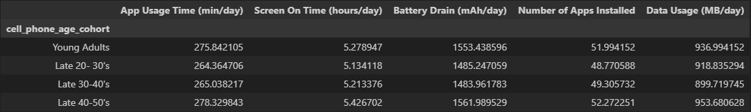
How Does Age Impact Phone Usage
When looking at raw averages of the five factors the young adults and late 40’s-50’s exhibit greater phone usage behavior.

Slide 10
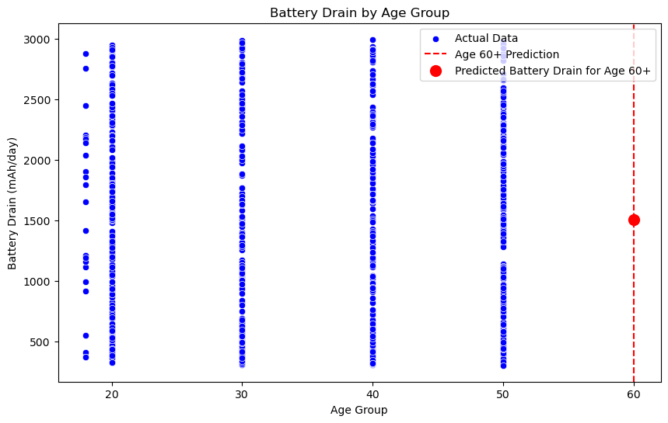
How Does Age Factor into Battery Drainage

Slide 11
Age & Drain Insights & Observations
High Usage Among Younger Users
The age group in their 20s shows the highest battery drain, which might indicate more frequent phone or app usage, possibly due to lifestyle or work habits.
More Consistent Patterns in Middle Age Groups
Age groups 30 to 50 have a narrower range of battery drain values, suggesting more regular or predictable usage patterns. This could be due to more balanced or habitual device usage.
Lower Predicted Battery Drain for 60+
The prediction line for age 60+ could indicate that users in this demographic typically use less data or drain less battery. This aligns with general trends that older users may use their devices less intensively.

Slide 12
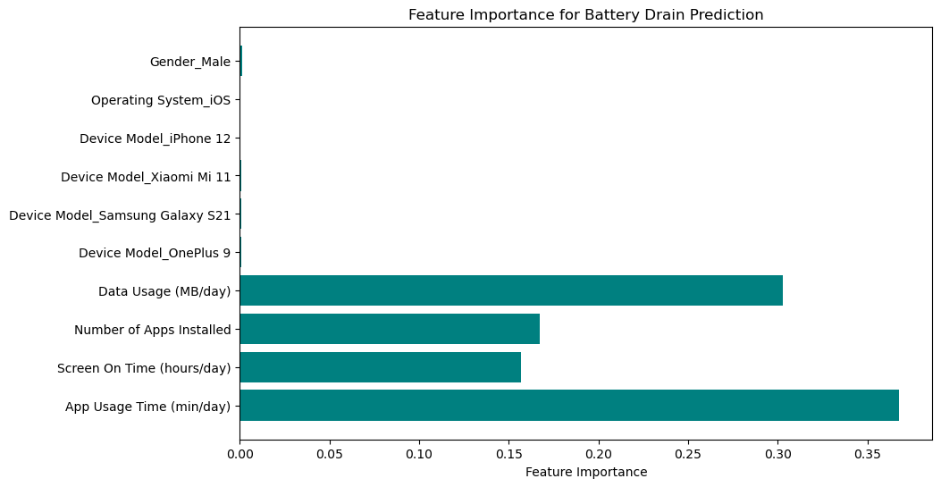
Device and Gender on the Five Factors

Slide 13
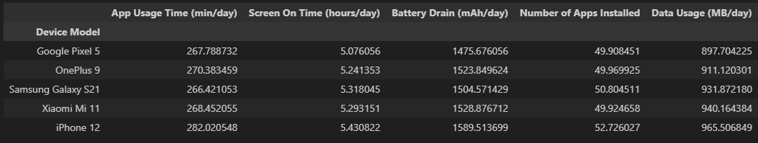
Device and Gender on the Five Factors
Devices matter
iPhone 12 universally higher usage among the five factors
Xiaomi Mi 11- 3rd highest App Usage, Screen Usage, time Apps installed but 2nd in data usage and battery drain
Screen On time iPhone 12
Battery drain iPhone 12

